Slide 1
Cloud warehouse monitoring Snowflake case study
JOSIP SABAN, M.Sc., E-MBA
Meridian data, owner

Slide 2
Agenda
How it starts ( motivation )?
What we built ( execution )?
What else do you need ( roadmap )?

Slide 3

Day one
You get a new toy – your first Snowflake instance
Ideally you read some documentation/watch some videos...or not ☺
You start moving data, testing out all the „cool” stuff from sales slides
It works ☺

Slide 4
How it starts?
Usually with one or more use cases:
On-premise is no longer sufficient to consume all data sources
We want use automated hardware scaling/software upgrades in cloud
We want to see if “cloud warehouse” works for us
We want to move from legacy tool stack to “something else”
Compliance frameworks are in place to support cloud analytic systems
You got some money to play with cloud ( and Snowflake ☺ )

Slide 5
How it starts?
We create basic administration ( users/roles/virtual warehouses )
We connect Snowflake to “outside world”
We get some data to the system
We onboard first users, usually giving them too much resources
Users, if they know SQL, start writing queries, usually sub-optimal
“Outside” performance is great and it all works, everyone is happy
Three to six months pass…all is great…and then you get a call ☺

Slide 6

How it starts?
Costs go up, Snowflake/cloud quarterly invoice comes, comes and…CFO calls:
“Can you explain what is this invoice we got for XXXXXX $?”
Usually there is no answer, and you cannot say “who did it”
“Operational monitoring or improvement” project starts

Slide 7
What we built ( execution )?
We created a set of monitoring reports, looking at every aspect of Snowflake – presented today is a subset of those reports
This data is shared across entire organization, it is ( internally ) public
Daily orchestrations are storing TOP X queries by length, user, virtual warehouse, role, task…
Reports are sent ( by email ) to people that are consuming significant resources
Slack notifications are created on dedicated channels on any event that is outside of acceptable performance/resource consumption rules
This was followed by defining rules how things should be done and monitoring for rule breaking, followed by trying to dynamically monitor queries/tasks

Slide 8
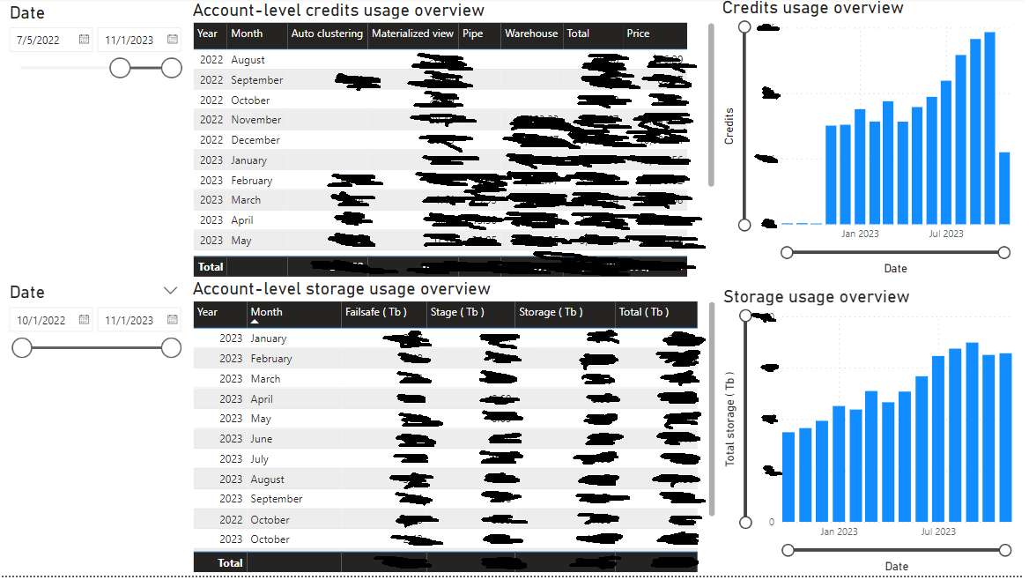
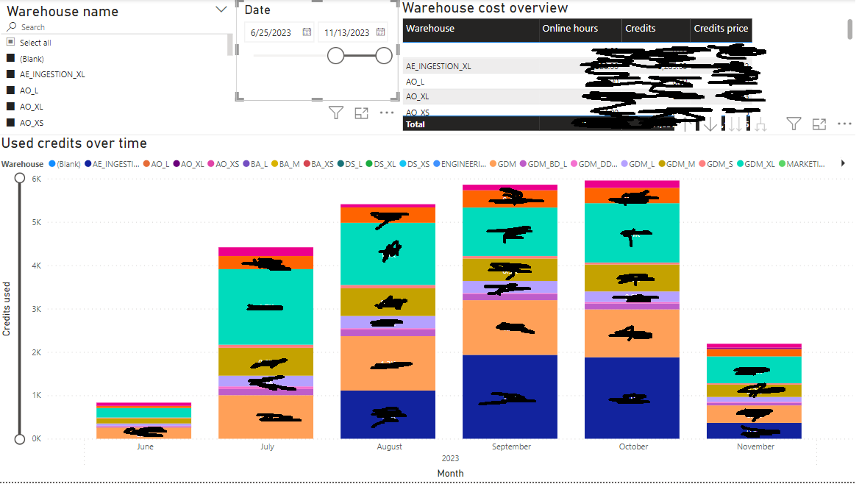
What we built ( execution )?
Account level overview
Warehouse level overview

Slide 9
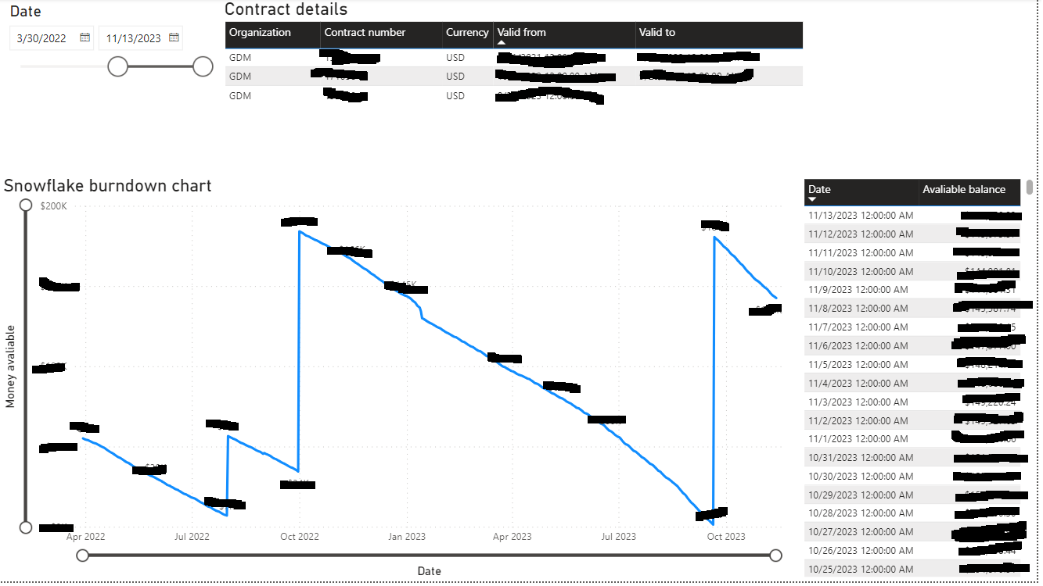
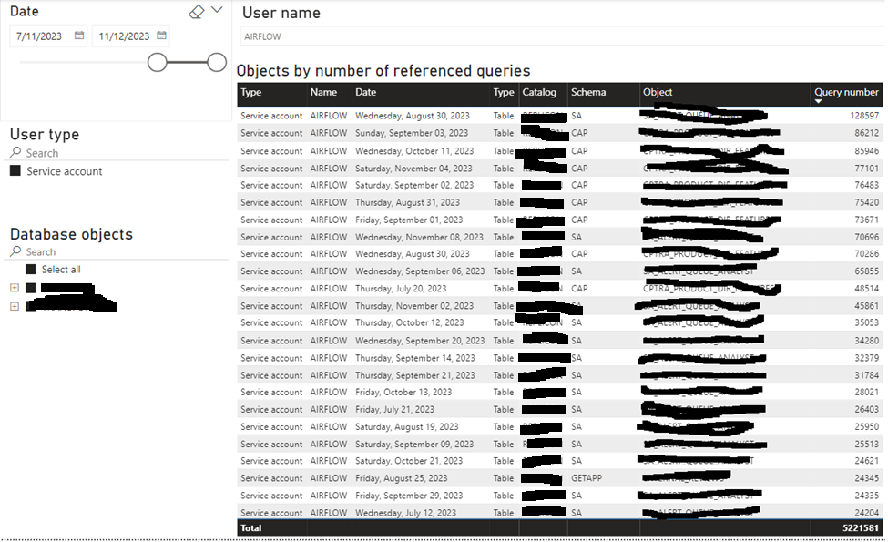
What we built ( execution )?
Burndown chart
Object usage overview

Slide 10
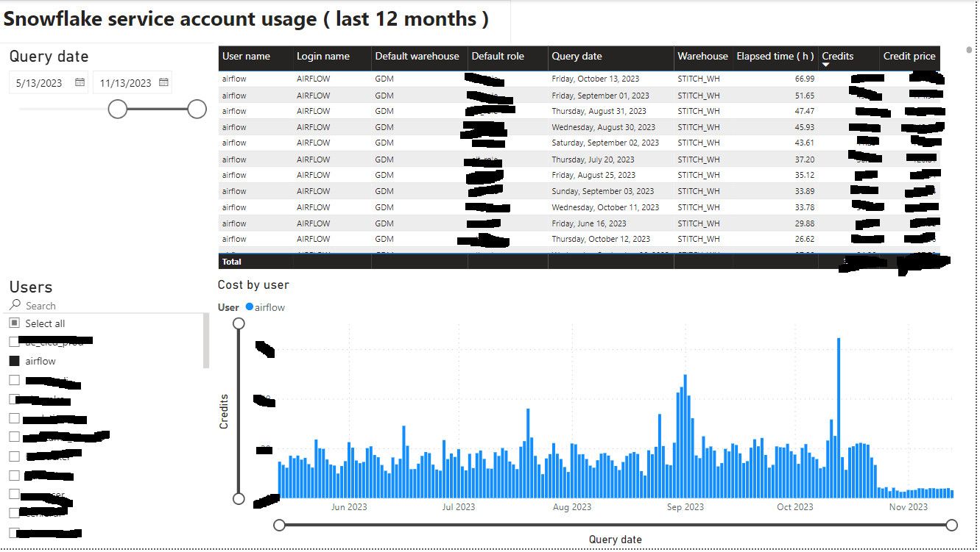
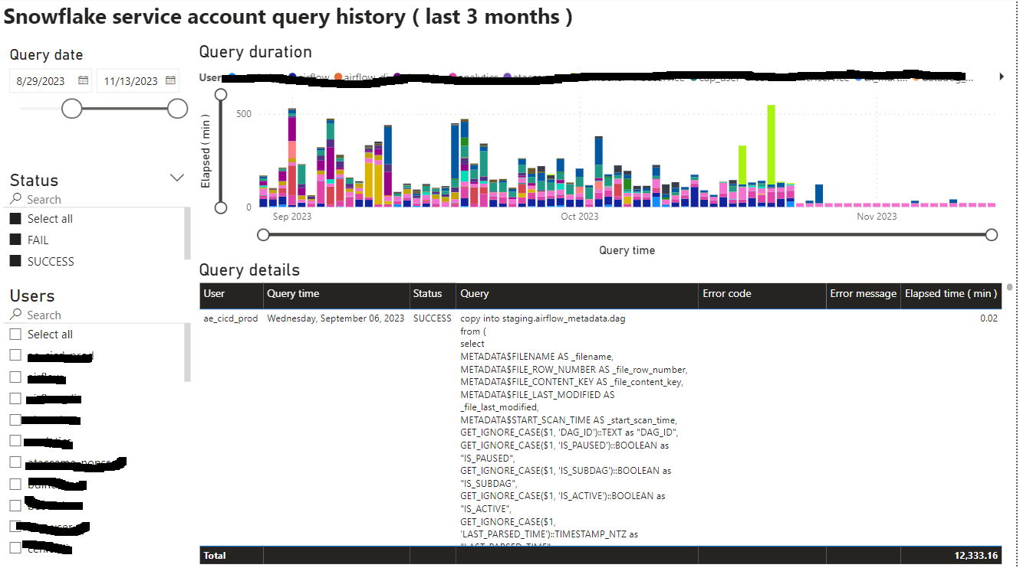
What we built ( execution )?
Service account usage

Slide 11
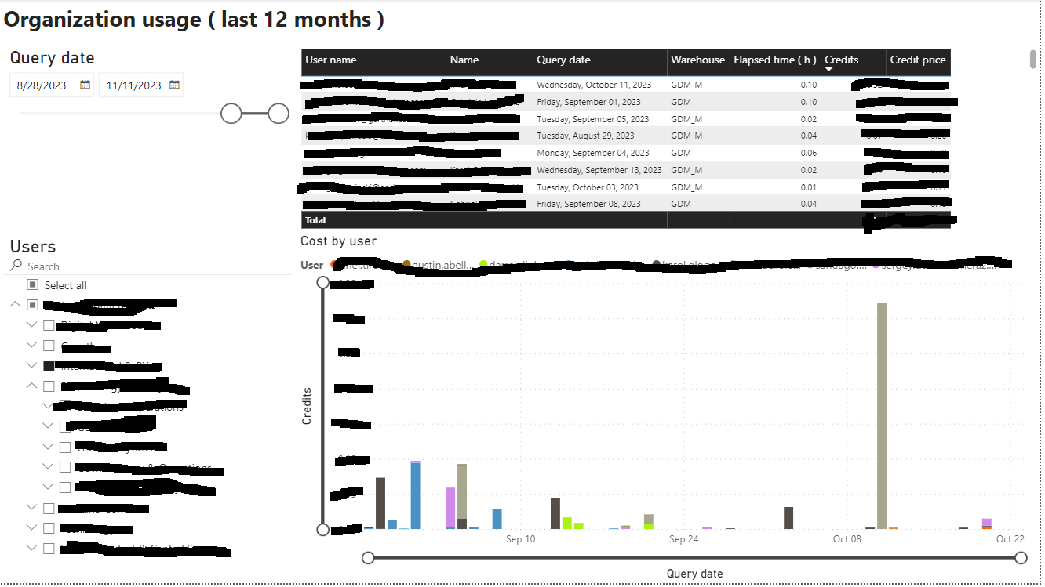
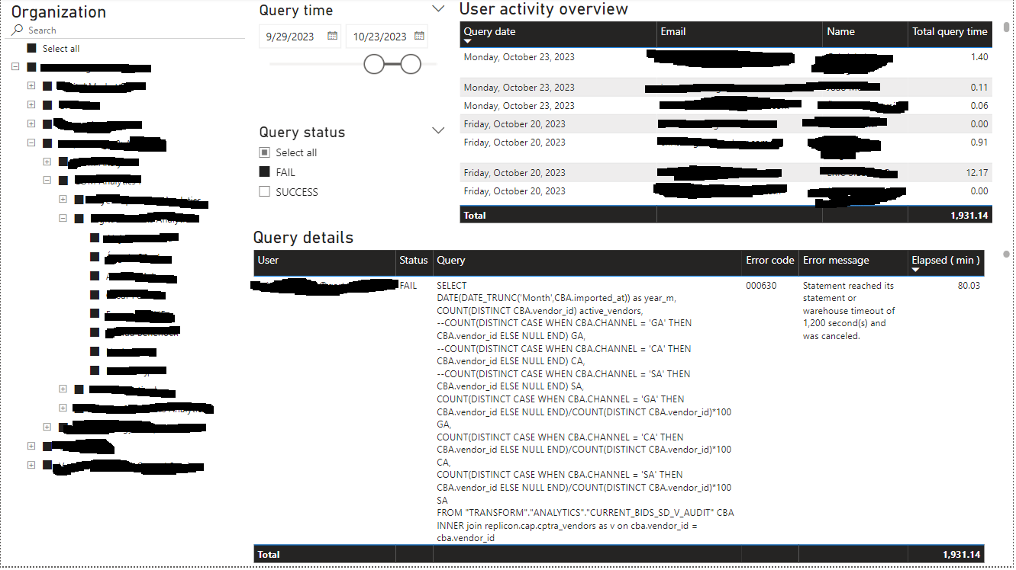
What we built ( execution )?
Organization usage

Slide 12
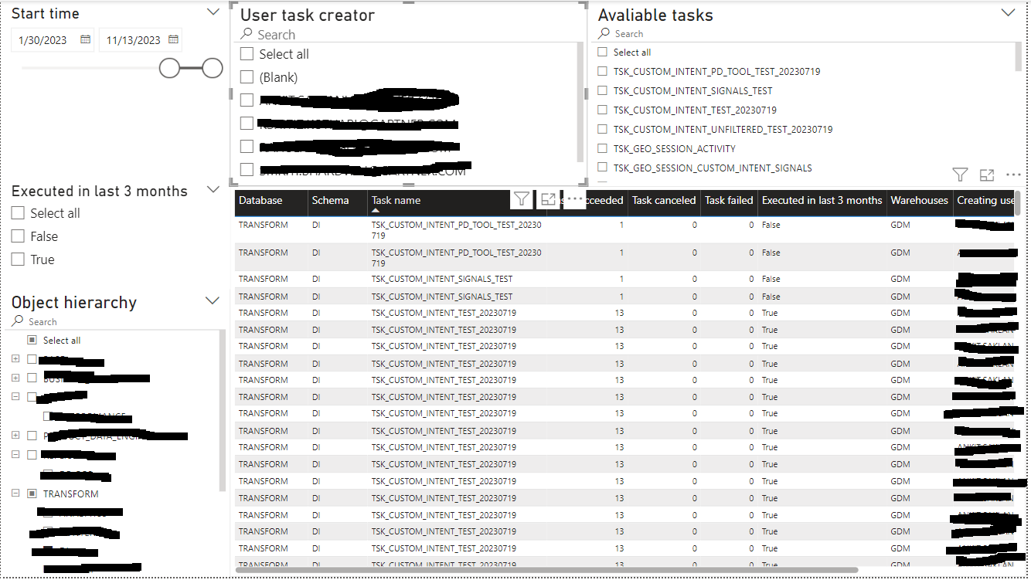
What we built ( execution )?
Task monitoring

Slide 13
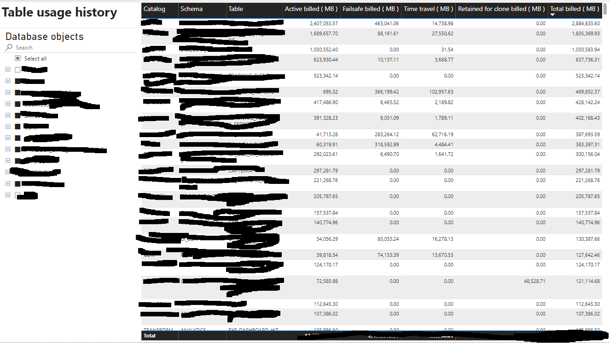
What we built ( execution )?
Table usage

Slide 14
What we built ( execution )?
What did we do after we enabled reporting?
Recreated user roles by org-chart, with minimally required privileges
Created a limited number of roles for service accounts
Started analysis on most popular/biggest tables
Started Snowflake task analysis and pro-actively contacted owners of most expensive ones
Started “serious” governance
Observing who is doing what and how
How users are using source data
Decreased size of warehouses after disabling/refactoring expensive queries
…

Slide 15
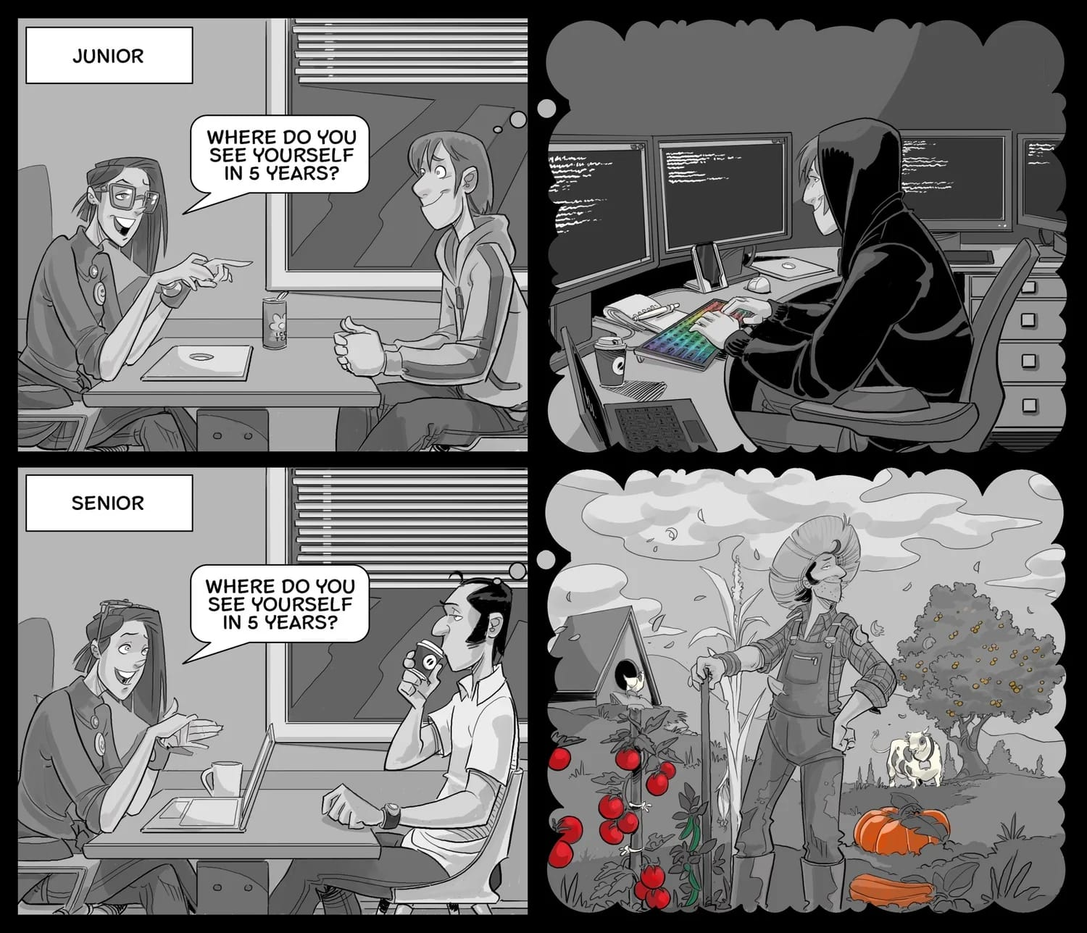
What else do you need ( roadmap )?
Monitoring new deployment performance
Tight(er) cost control and user privileges
Awareness of new database features
User educations on proper database use
Roadmap into user product/delivery plans

Slide 16

Q&A
Josip Saban, M. Sc., E-MBA
Meridian data, owner
josip.saban@meridian-data.hr
josipsaban@gmail.com
+385 95 9041804
+43 664 88161370

